Slide 1
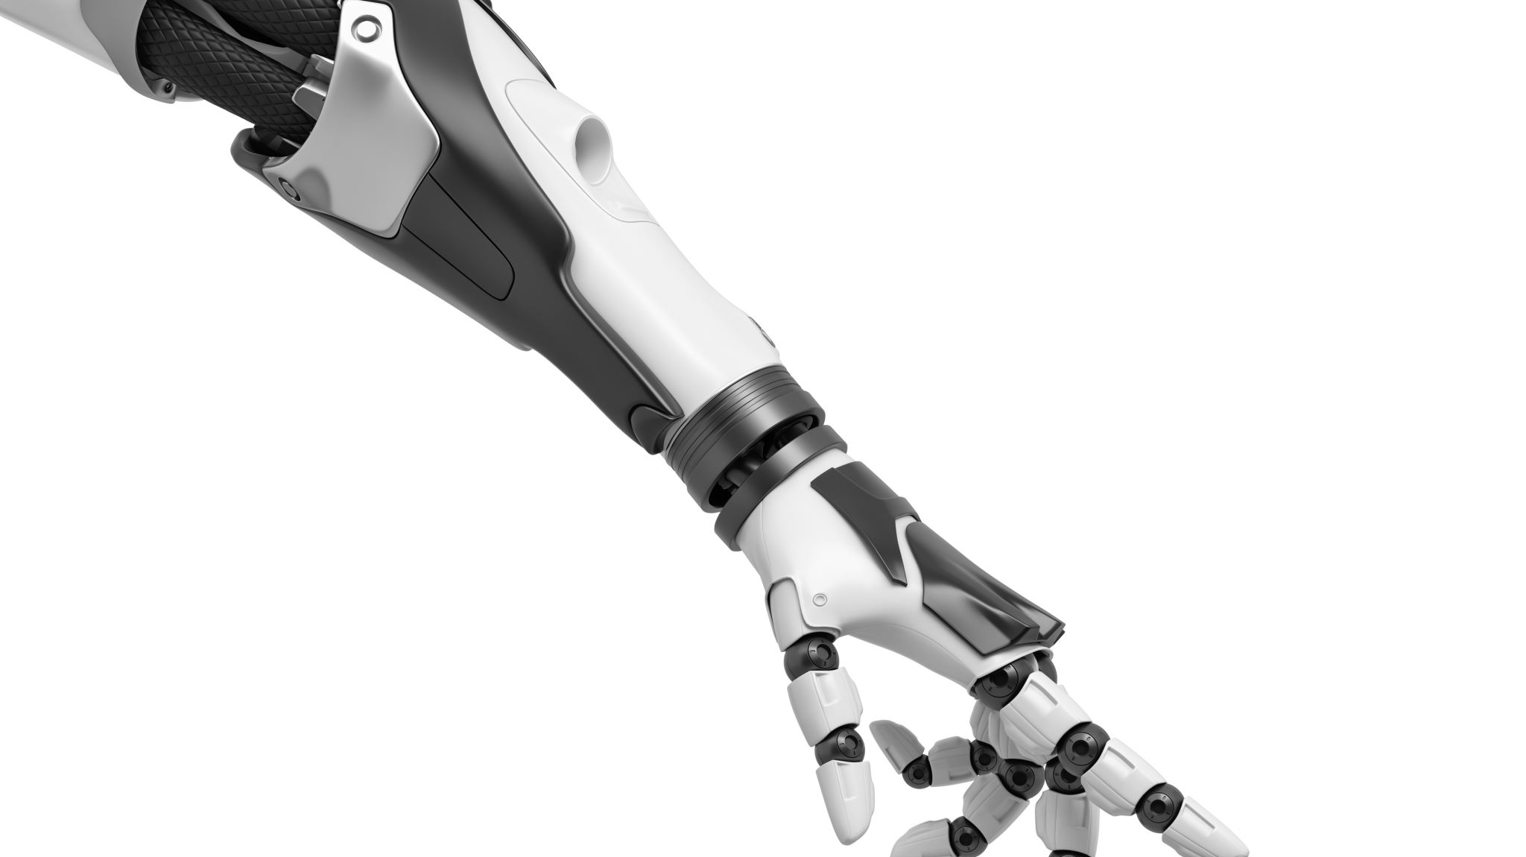
Electronic Prosthetic Arm
Submitted by
Samy Gerges Samy
Mohammed Saad Fathy
Ibrahim El-Sayed Mohammed Supervisor By
Nashaat Baher Mohammed DR\Ghada Kareem
Islam Sobhy Soliman
Gaser Tarek Helmy

Slide 2
First agenda
Overview of the Human Arm Anatomy
Bones, Joints, Muscles
Review Arm Motion
Kinematics: types of motion, location of motion, direction of motion, magnitude of motion, and degrees of freedom
Kinetics: extrinsic forces, intrinsic forces, force vectors, force of gravity, reaction forces, additional linear forces, and classes of levers
Overview of the Prosthetic Arm
Building the Model
Building the Display

Slide 3
Bones of the Upper Extremity
Humerus
The longest and largest bone in the upper extremity.
Ulna
A long bone in the forearm parallel with the radius; at the proximal is the elbow and the distal end is the wrist.
Radius
The other bone of the forearm, shorter than the ulna.

Slide 4
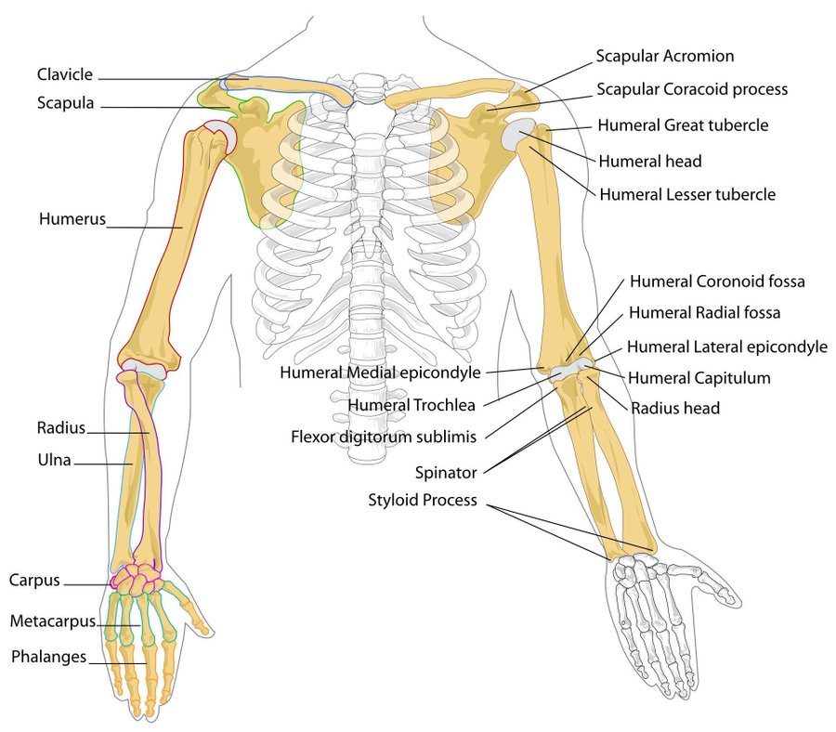

Slide 5
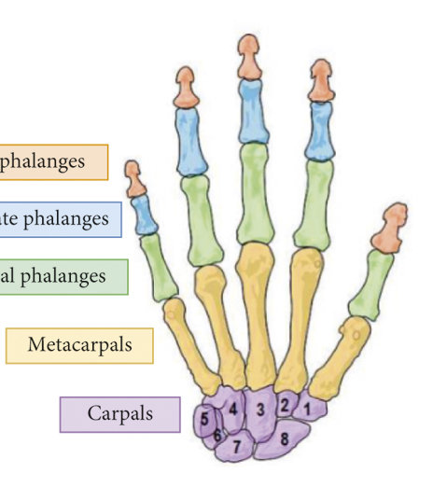
Bones of the Hand
Carpals
The wrist is composed of 8 separate carpal bones.
Metacarpals
The intermediate part of the hand skeleton that is between the carpals and the phalanges (up to the knuckles); 5 metacarpal cylindrical bones
Phalanges
The fingers of the hand contain 14 digital bones.

Slide 6
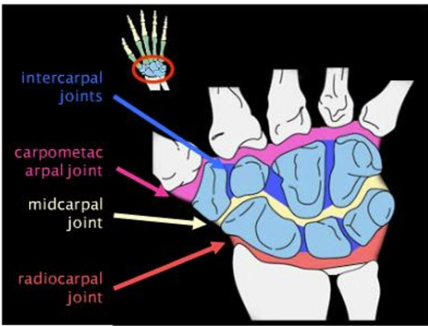
Joints
Elbow Joint/Complex
Humeroulnar Joint - simple hinge-joint
Humeroradial Joint - arthrodial joint allowing gliding and sliding motions
Proximal Radioulnar Joint - pivot joint
Wrist Joint
Radiocarpal joint
Carpometacarpal joints
Intercarpal joints

Slide 7
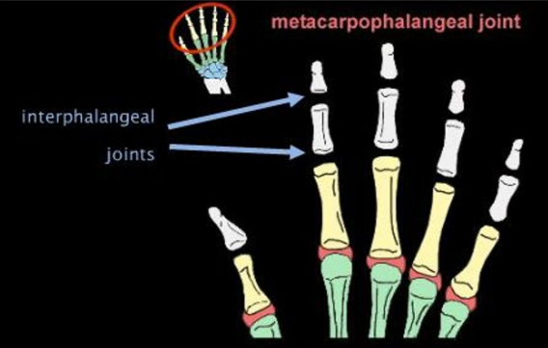
Metacarpophalangeal Joints
Interphalangeal Joints

Slide 8
Movements
Flexion: decreasing joint angle such as bending
Extension: increased joint angle such as stretching
Abduction: movement that draws limb away from sagittal plane
Adduction: movement which brings limb closer to the sagittal plane
Supination: palm faces up
Pronation: palm faces down
Circumduction: combination of flexion, extension, abduction and adduction

Slide 9
muscles
Upper Arm
Biceps brachii, brachialis, coracobrachialis
Forearm
Flexor-pronator and extensor-supinator
Hand
Thenar, hypothenar, interosseous, lumbrical

Slide 10
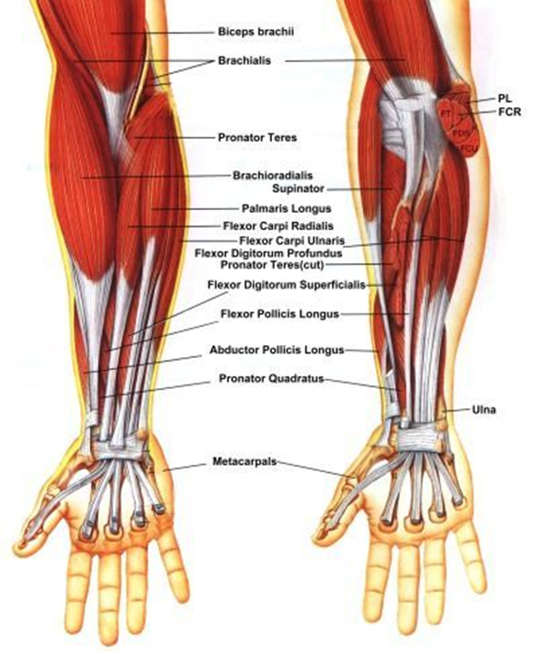
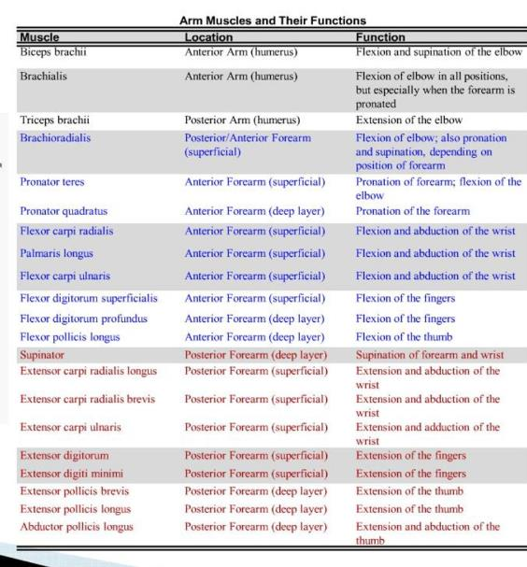

Slide 11
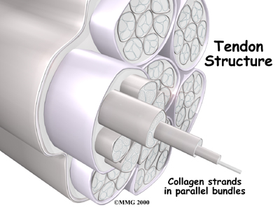
Tendons
Tough bands of fibrous connective tissue that connects muscles to bones.
Capable of withstanding tension
Function to transmit force
Function as springs

Slide 12
Arm Motion – Kinematics
Types of Motion
Translatory: all parts move toward same direction
Rotatory/Angular: around a fixed axis
General: combination of translation and rotation
Location of Motion
Transverse or Horizontal Plane
Superior and Inferior
Coronal or Frontal Plane
Anterior and Posterior
Sagittal plane
Medial and Lateral

Slide 13
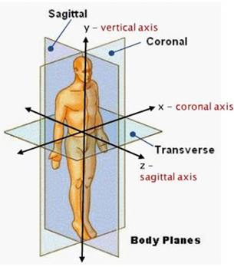
Rotatory motion occurs around a fixed axis.
Axis of rotation | Direction of motion | Perpendicular to
Sagittal axis (anterior posterior axis) | Horizontally from front to back | Coronal plane
Coronal axis (frontal axis) | Horizontally from side to side | Sagittal plane
Vertical axis | Perpendicular to ground | Transverse plane

Slide 14
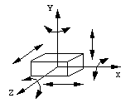
Degrees of Freedom
3 translatory motions along the x, y, and z axes and
3 rotatory motions around the x, y, and z axes
6 DOF of a rigid body
Moving up and down
Moving left and right
Moving forward and backward
Tilting forward and backward (pitch)
Turning left and right (yaw)
Tilting side to side (roll)

Slide 15
Arm Motion - Kinetics
Extrinsic Forces
Intrinsic Forces

Slide 16
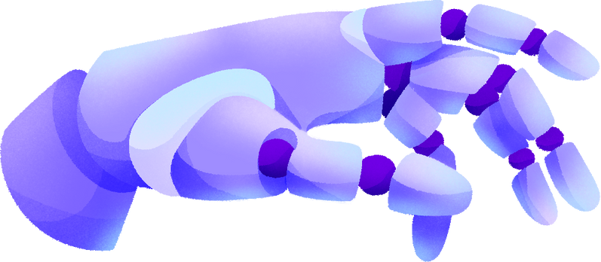

Second agenda
Introduction
History and Development
Anatomy and Function
Methodology
Results and Achievements
Future direction

Slide 17

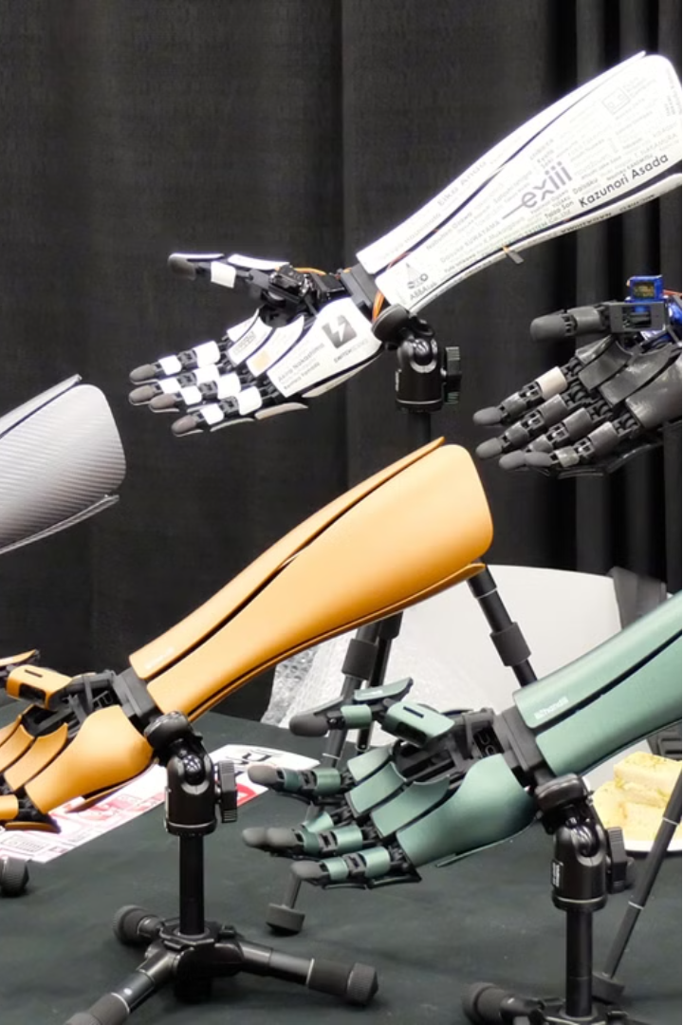

Introduction to Electronic Prosthetic Arm
Advanced robotic arms restore function for limb loss or difference, mimicking natural movements for greater independence and improved quality of life.

Slide 18
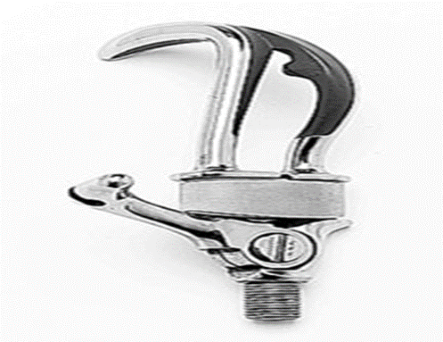
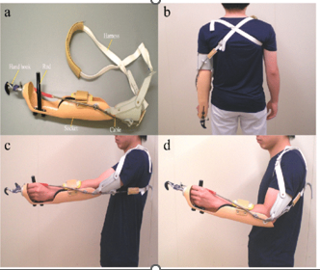
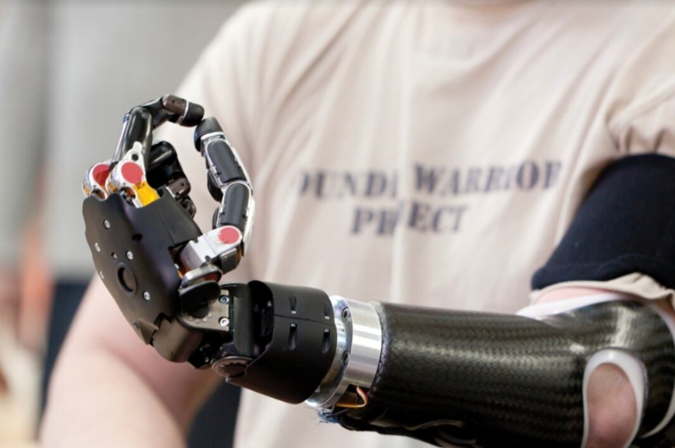
History and Development of Prosthetic Limbs
1
Early Prosthetics
Prosthetic limbs have been used for centuries, with some of the earliest known examples dating back to ancient Egypt and Greece.
2
Modern Advancements
In the 20th century, the development of new materials and technologies led to significant improvements in prosthetic design, allowing for greater functionality and comfort for users.
3
Electronic Prosthetics
The integration of electrical and computer systems in the late 20th century revolutionized prosthetic limbs, enabling more natural and intuitive control through sensors and advanced control algorithms.

Slide 19
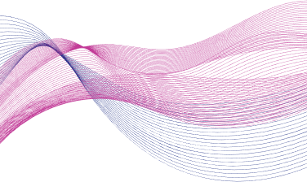
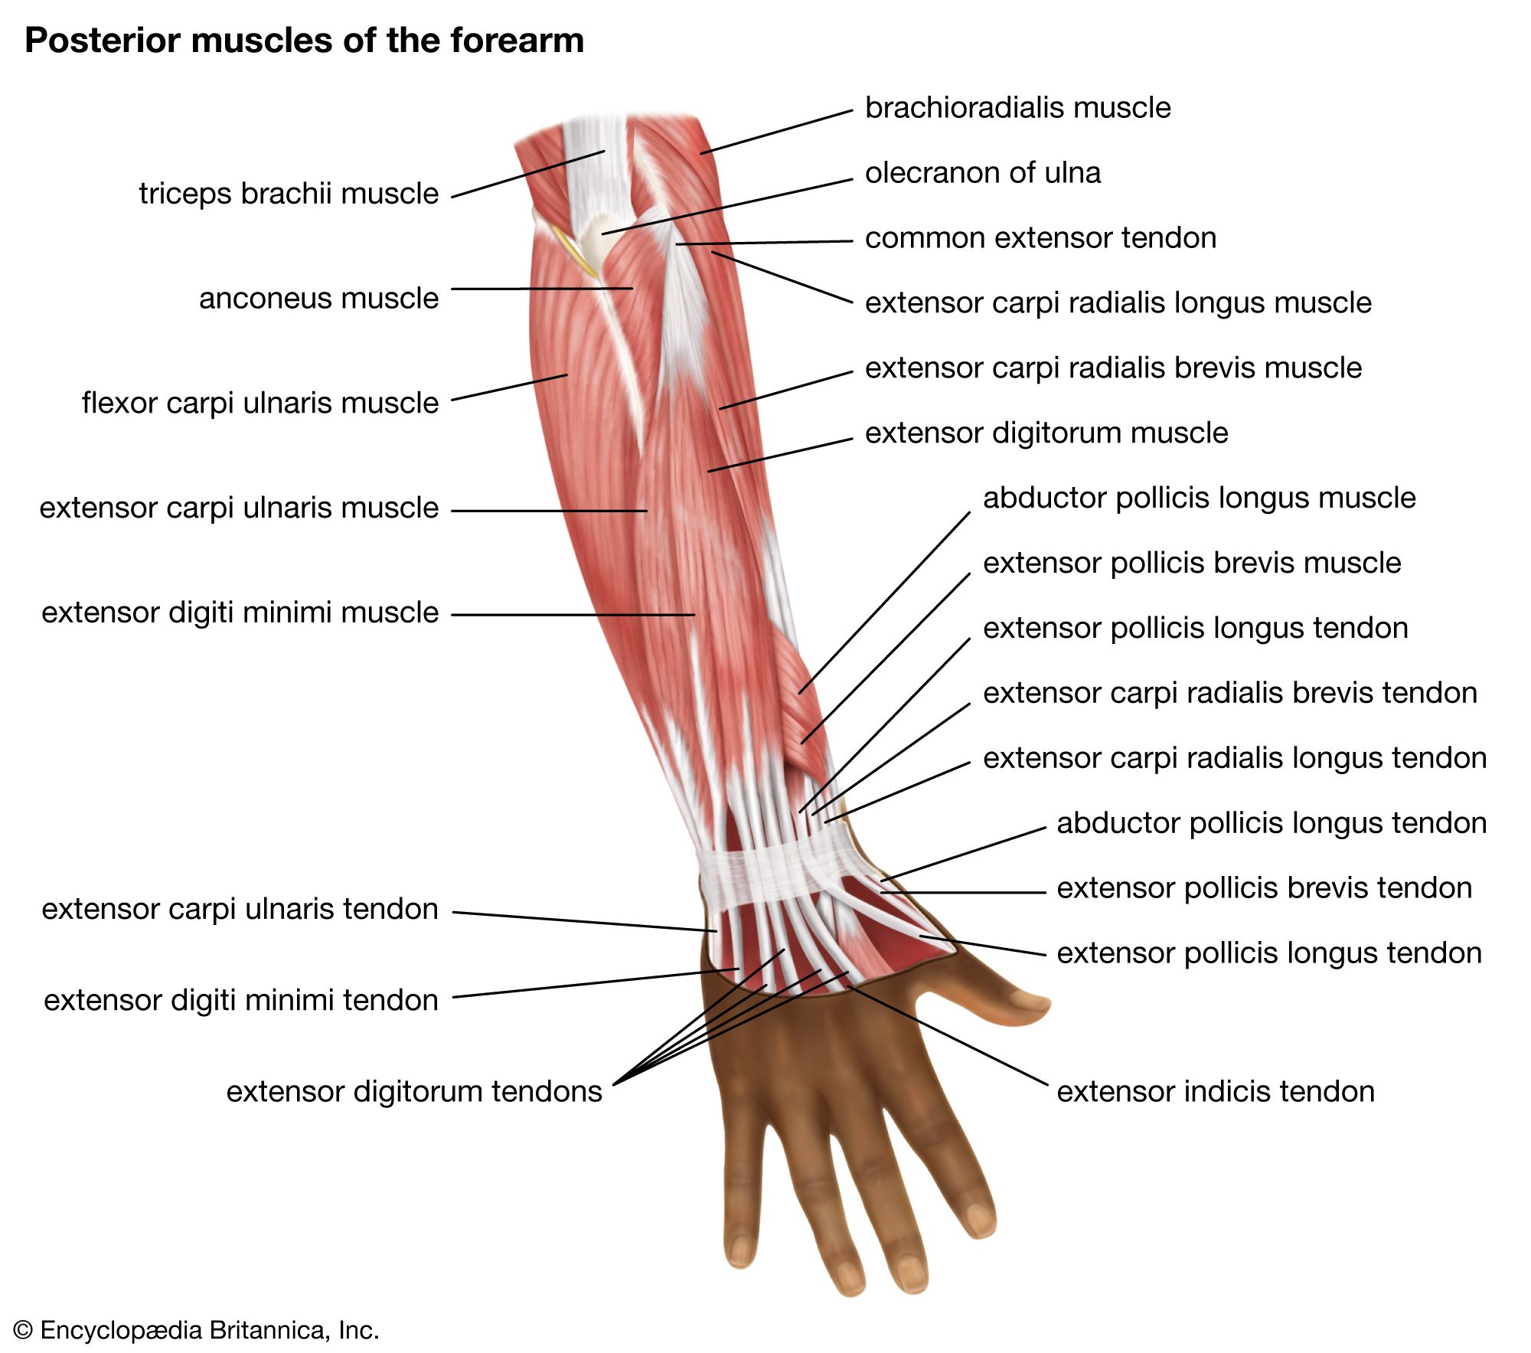
Anatomy and Function of the Human Arm
Skeletal Structure
Nervous System
Muscular System

Slide 20

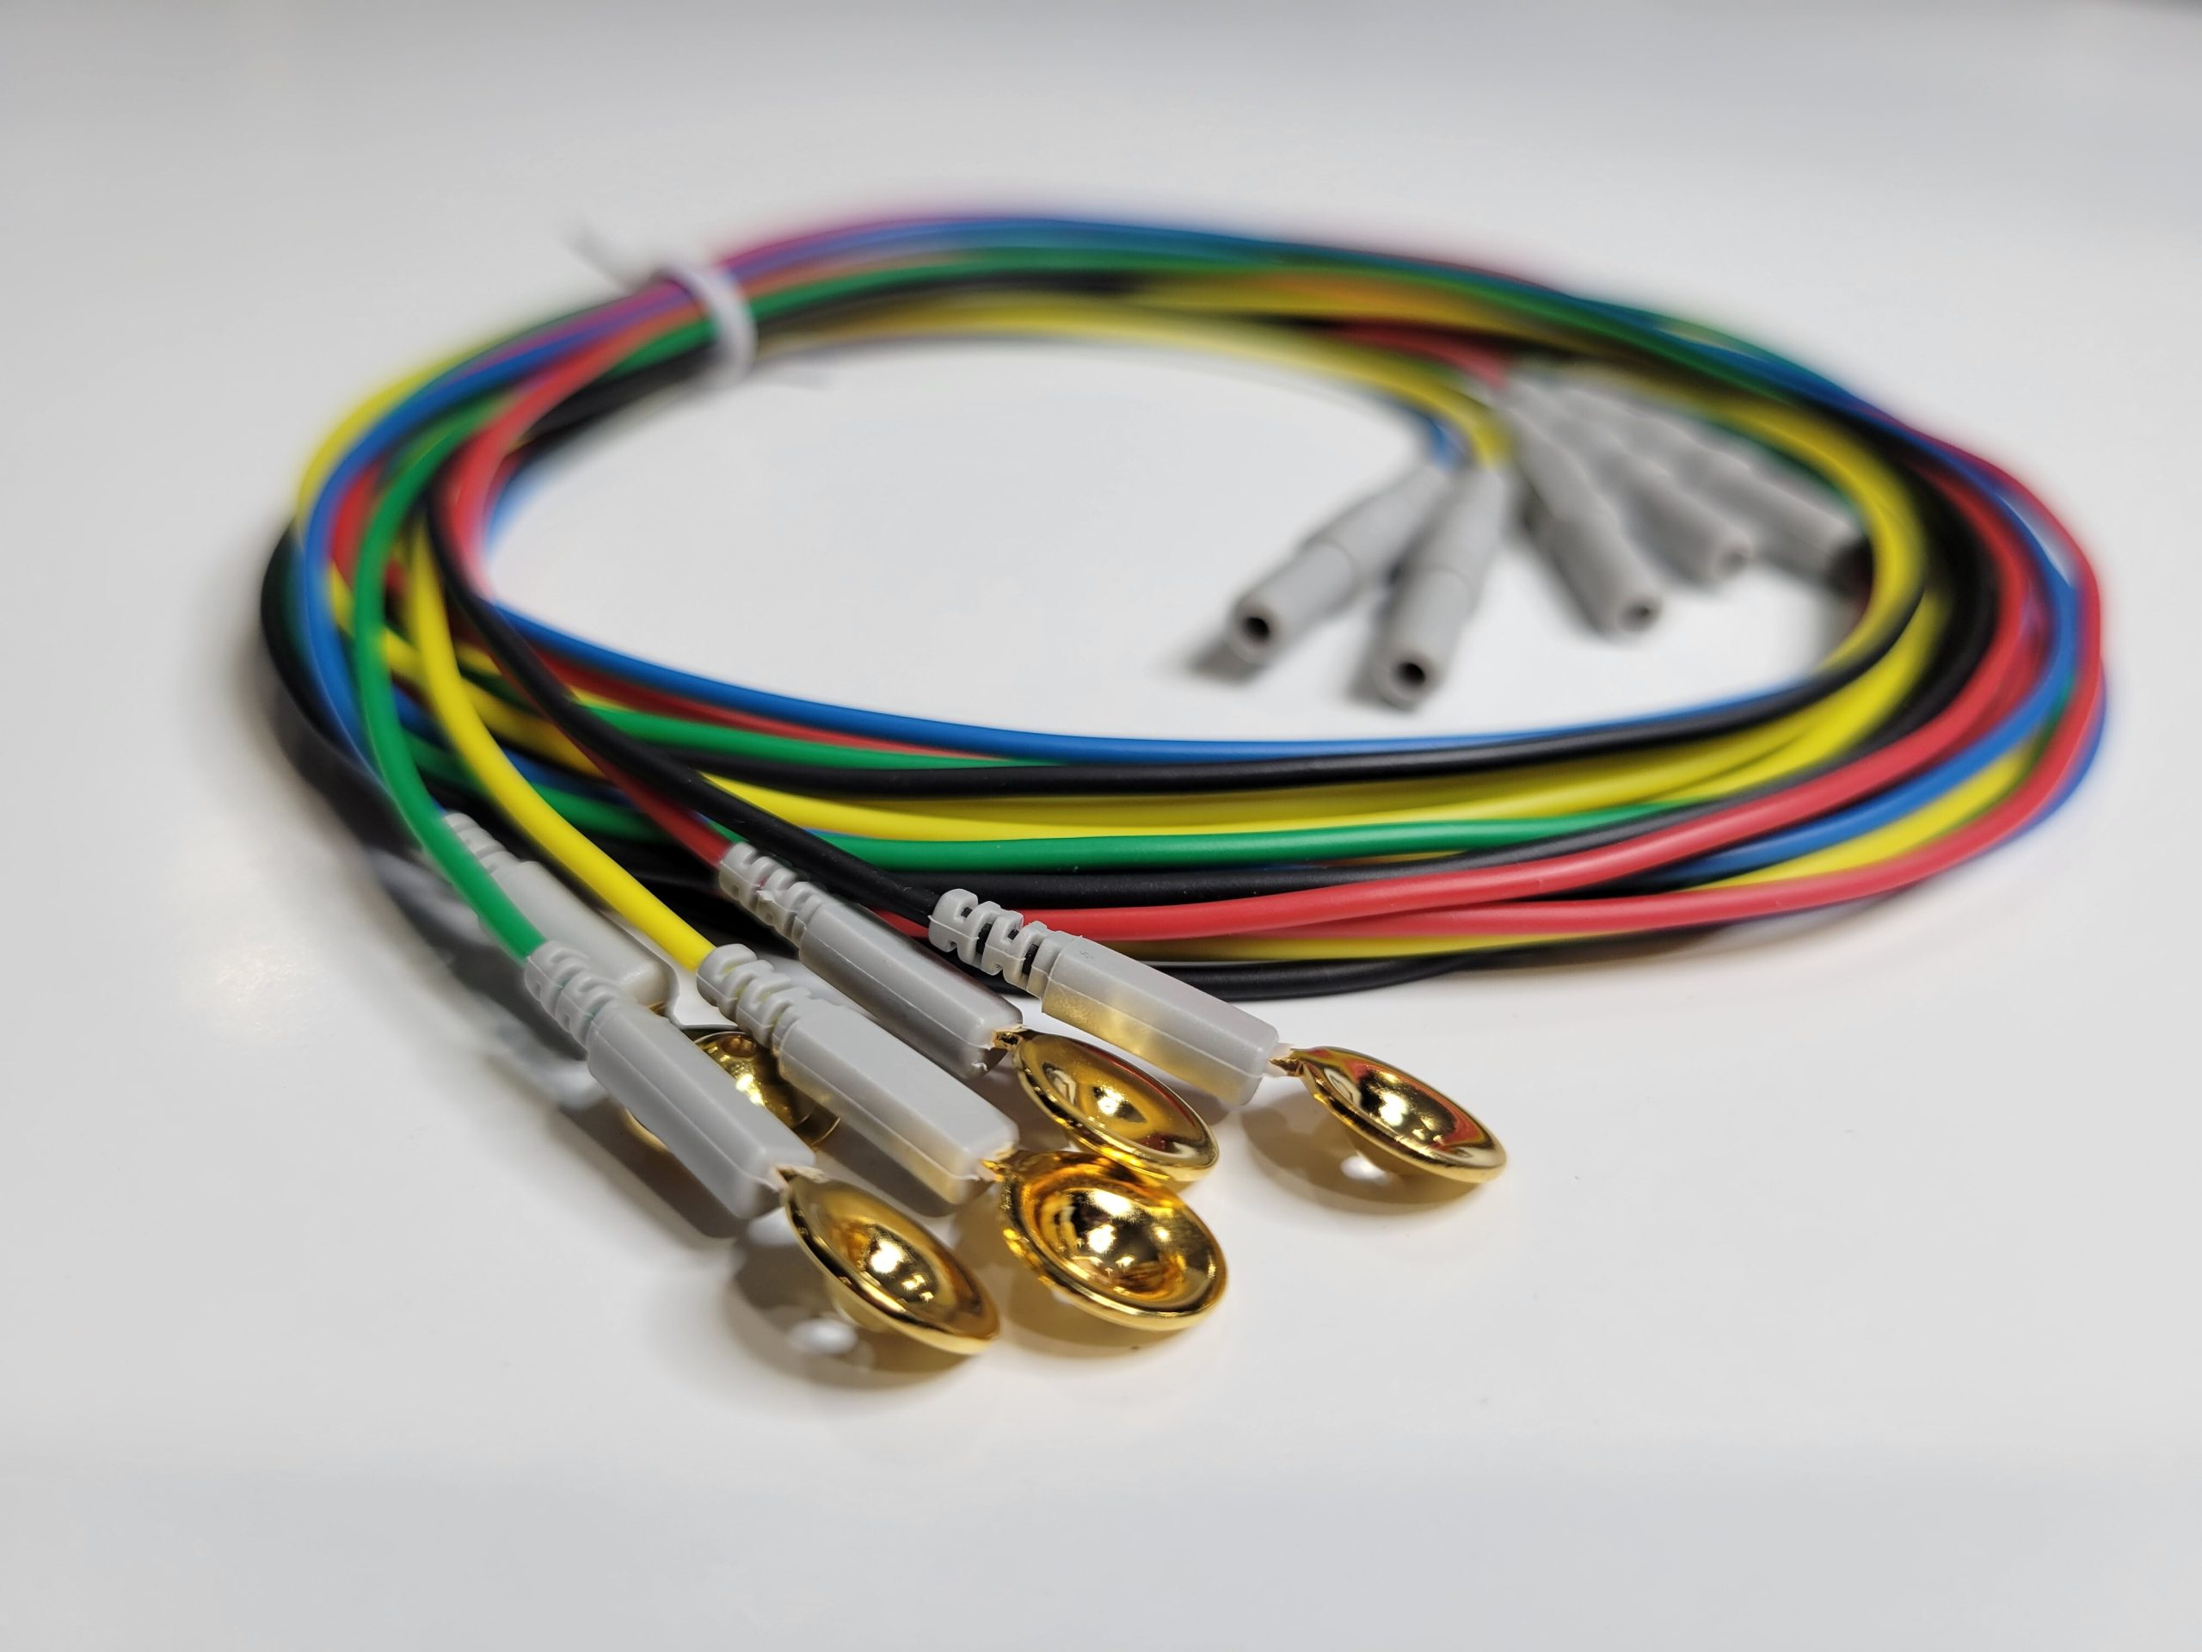
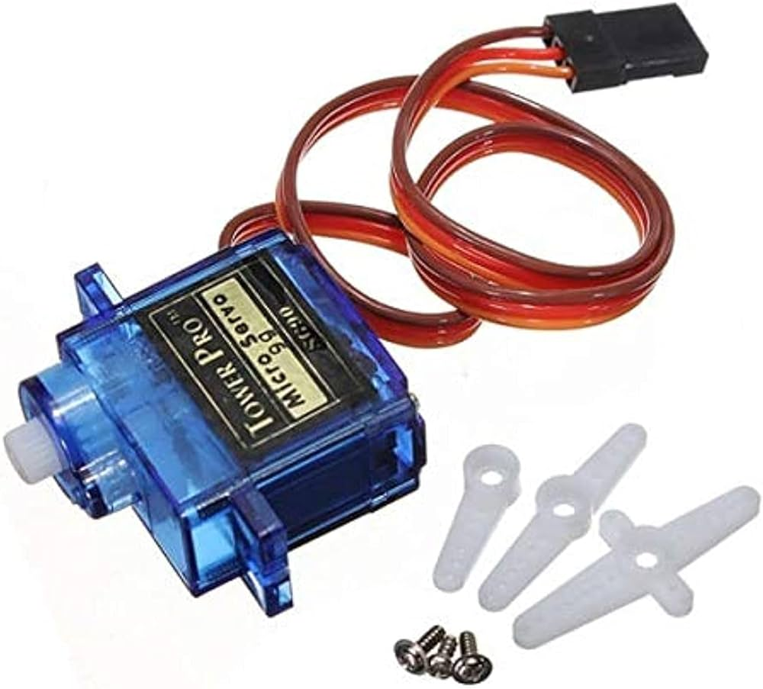

Principles of Electrical Engineering
1
Sensors
2
Actuators
Prosthetic arms utilize a variety of sensors, such as force, pressure, and position sensors
Electromechanical actuators, like motors are responsible for translating the control signals into physical movements of the prosthetic limb.

Slide 21
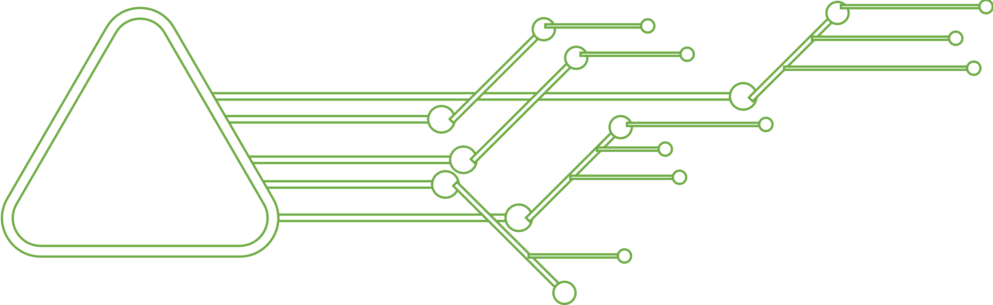
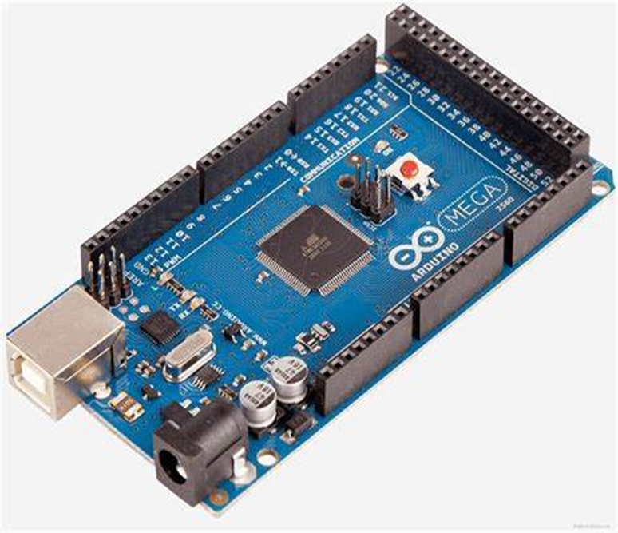
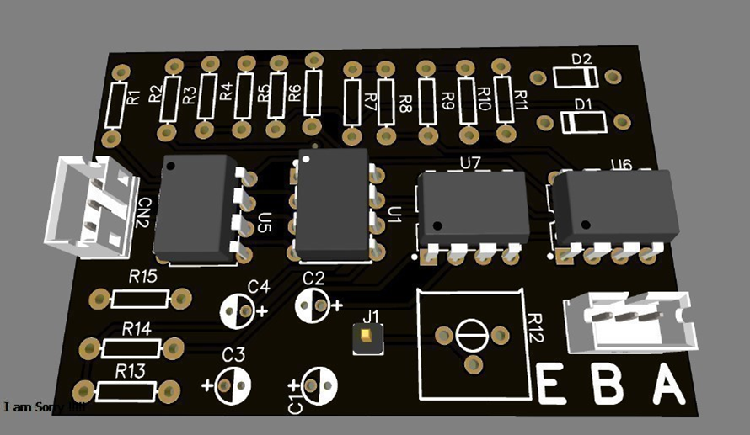
Principles of Electrical Engineering
3
Power and Control
4
amplification & filtration circuit
Onboard microcontrollers and power sources enable the prosthetic arm to function autonomously.
Amplification and filtration circuits enhance signals for improved sensing and motor control in electronic prosthetic arms.

Slide 22
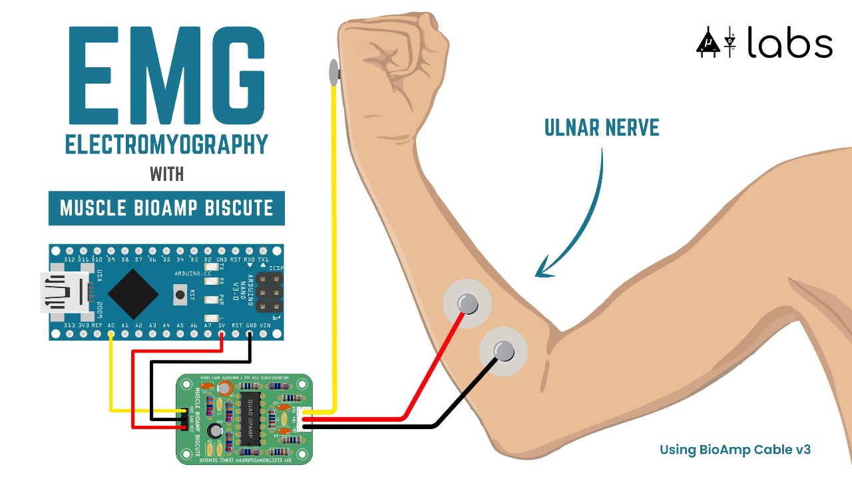
Block diagram of a hand with wires attached to a circuit board

Slide 23

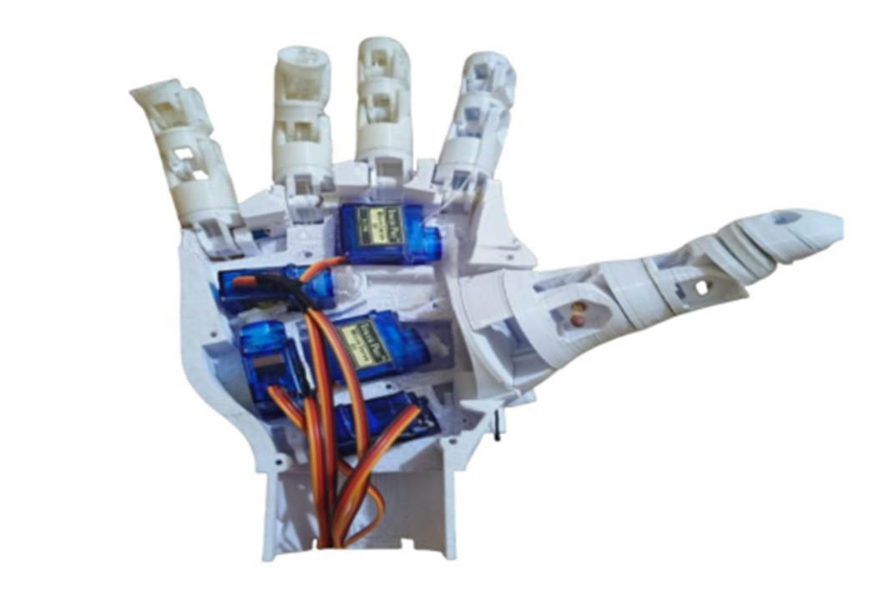
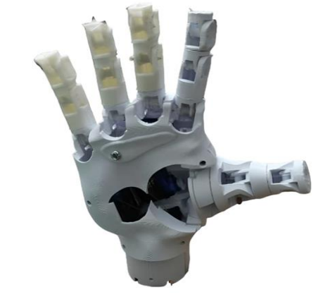
Results and Achievements

Slide 24
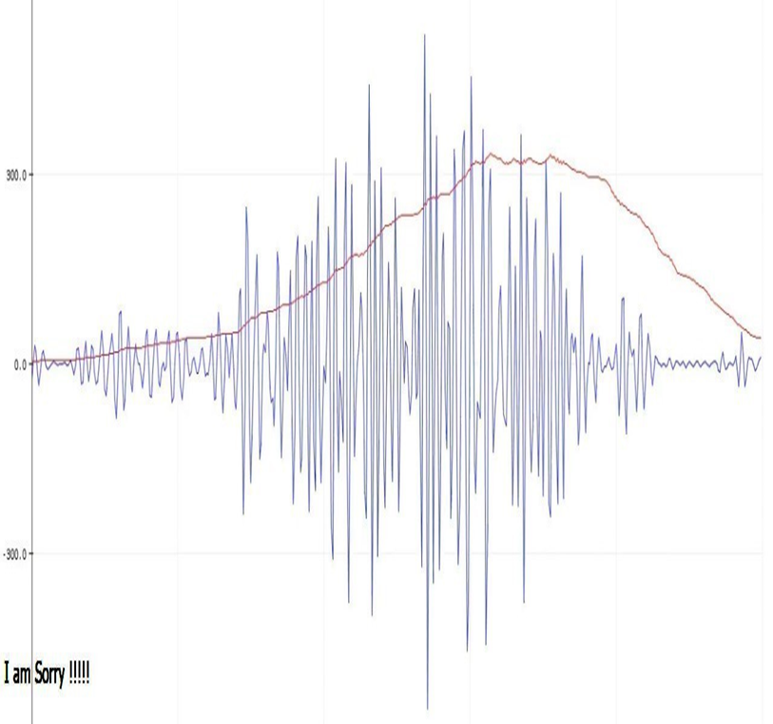
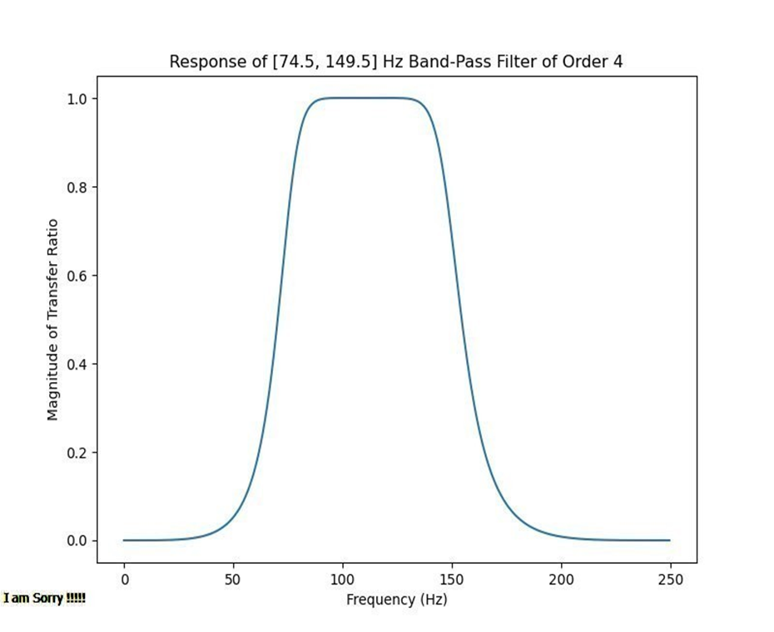
Recorded EMG signal

Slide 25





Challenges and Limitations
Weight and Comfort
Limited Functionality
Sensor Feedback
Cost

Slide 26


Future direction
Miniaturization and wearable technology
Wireless connectivity for remote monitoring
Advancements in signal processing algorithms

